Slide 1



International Resource for Infection Control (iNRIC)
Team 42
Andrei Boscor (andrei.boscor.14@ucl.ac.uk)
Do Xuan Bach (xuan.do.14@ucl.ac.uk)
Team Website: http://students.cs.ucl.ac.uk/2015/group42/
Dr. Patty Kostkova, UCL
Sue Wiseman
Fortune NCube
Alexandru Marginean
(founded with WHO, ECDC
HPA)

Slide 2
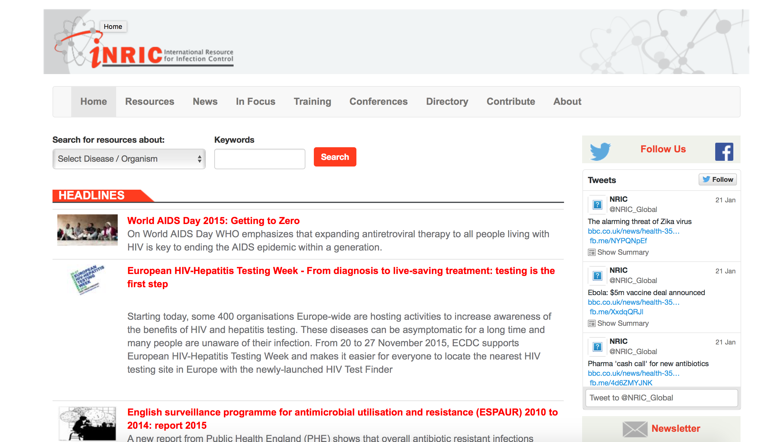
iNRIC Website

Slide 3
Issues with current setup
Not all countries have access to fast internet or computers
The adoption rate of low-end Android phones, Windows phones and old iPhones is much higher than that of computers
Many users want an app to personalise and speed up their searching
Be notified of new content

Slide 4
Key requirements
Cross-platform app available on most iOS, Android and Windows phones
User Profile with saved preferences
Quick Searching with user preferences
In App Browser to not switch between app and native phone browser
Low data usage
Notifications

Slide 5
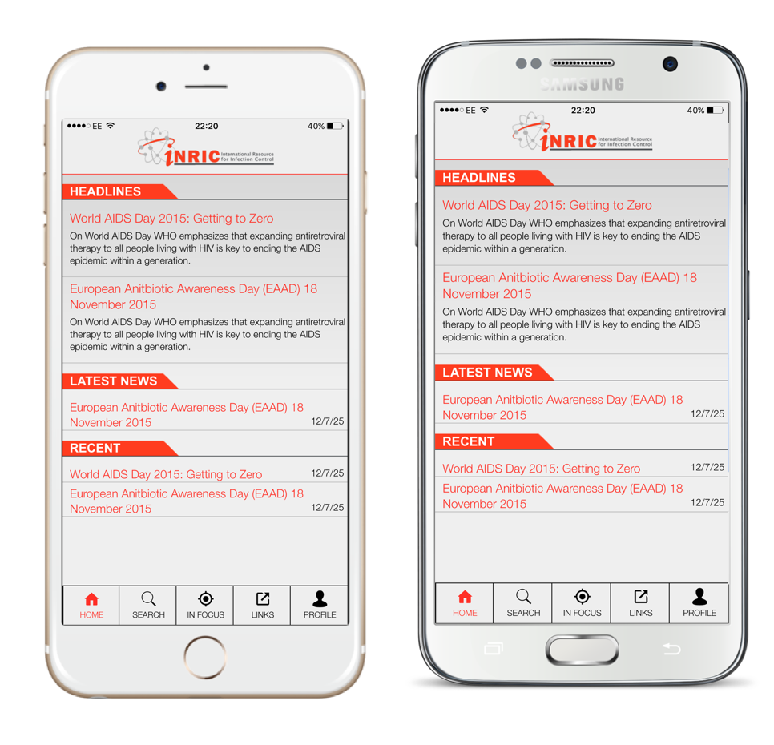

Our solution
Our solution is the iNRIC app
Cross-platform
Provides access to all iNRIC resources

Slide 6


Cross-platform
Built with HTML5, CSS3, Javascript (jQuery)
Ported with PhoneGap
Easy to add more functionality for all platforms at once

Slide 7
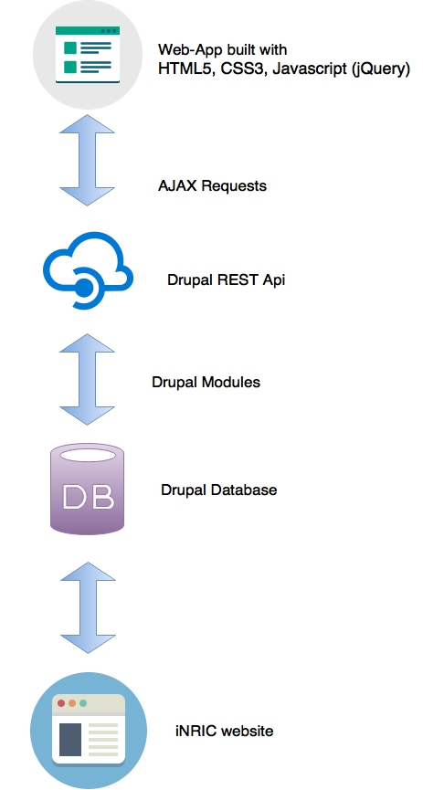

Low data usage
Main iNRIC website is built on Drupal 7
The app uses the Drupal iNRIC Portal as a RESTful Web Service
AJAX requests to obtain resource data from the Web Service

Slide 8
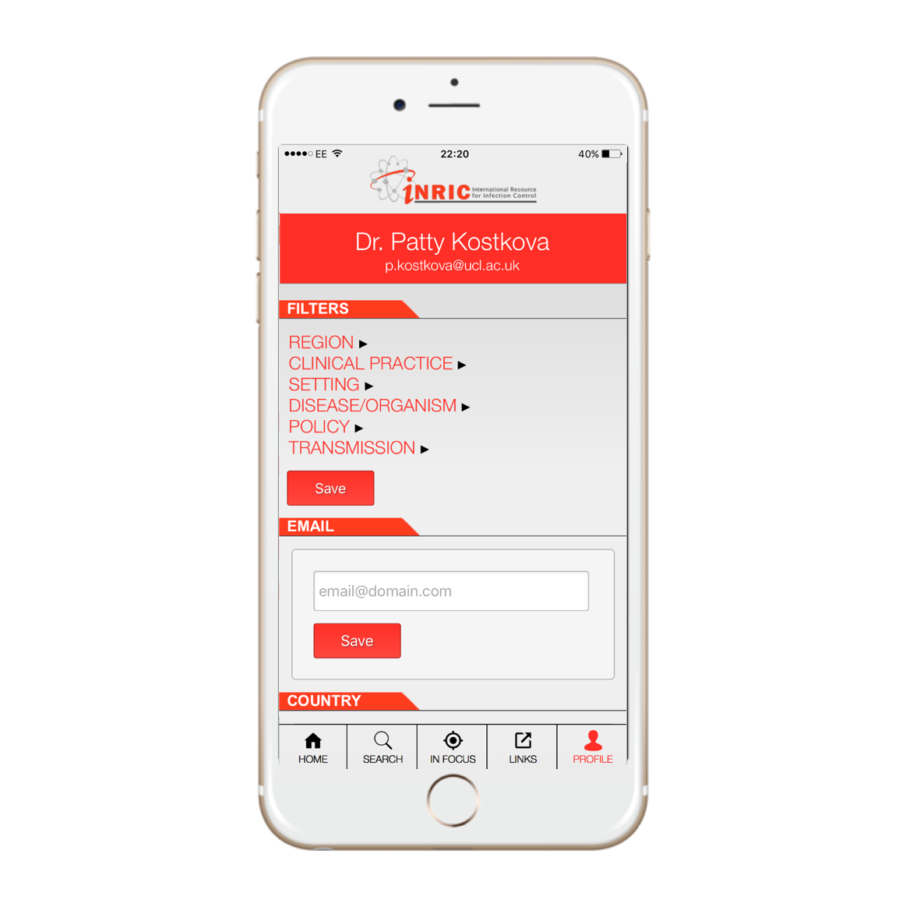
User profiles
Users can change their Account Details
Users can save their searching preferences

Slide 9
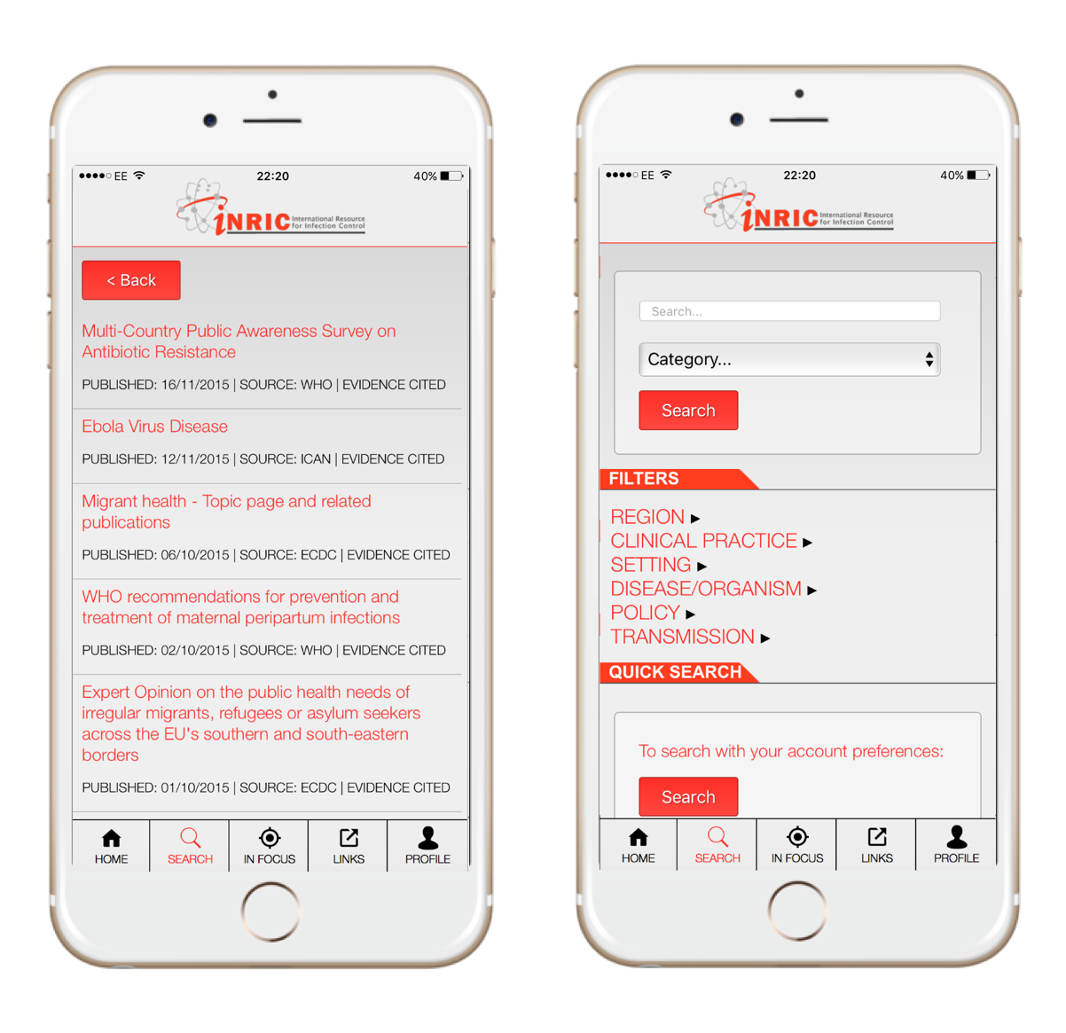
Quick Searching
Users can search exactly like on the iNRIC website
Or they can quickly search with their saved Preferences
Can view all resources in the inApp Browser

Slide 10
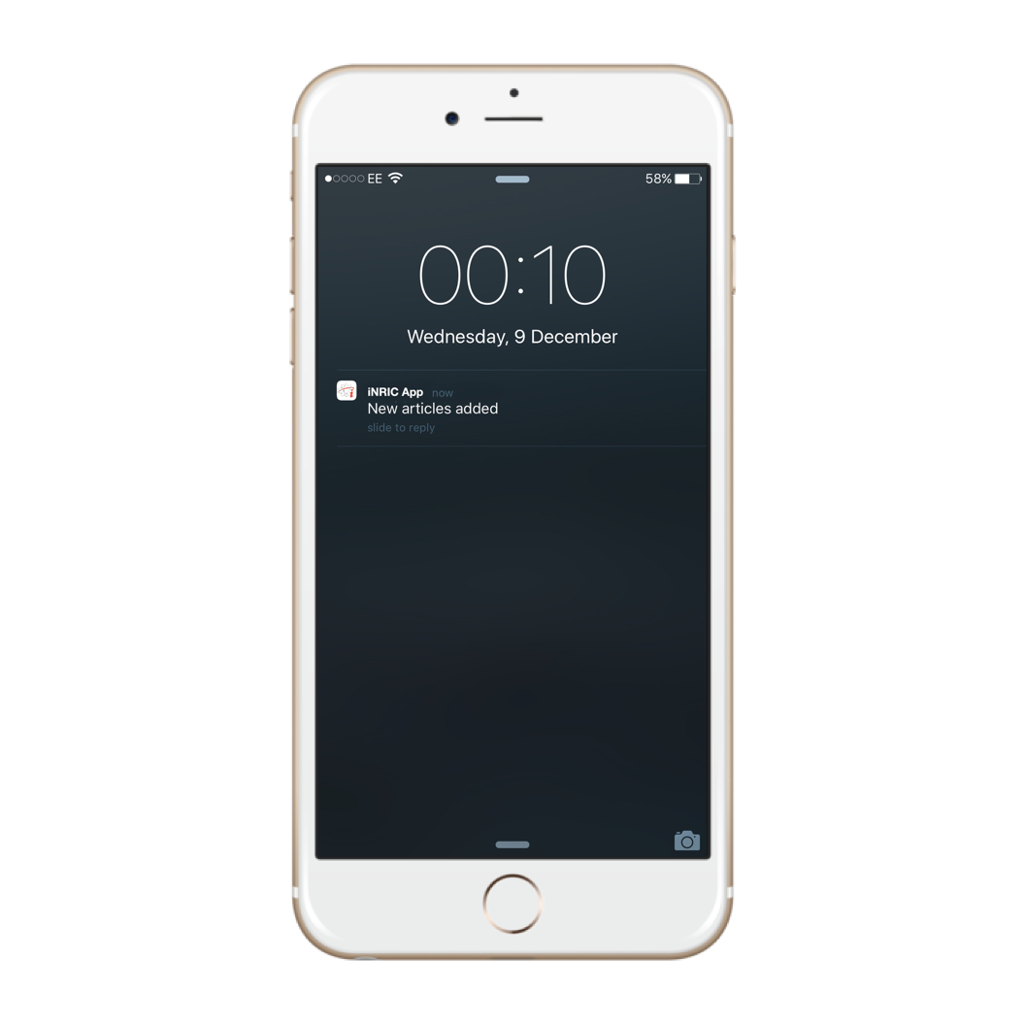
Notifications
The app is using PushWoosh notifications
Notifications can be sent directly by iNRIC content manager to all users

Slide 11
User Testing
Responsive Design mode testing in Safari and Google Chrome for multiple screen sizes
Tested with the Phonegap Developer app on iOS and Android phones
A/B Testing conducted with students and medical staff
AJAX Requests tested with Postman

Slide 12
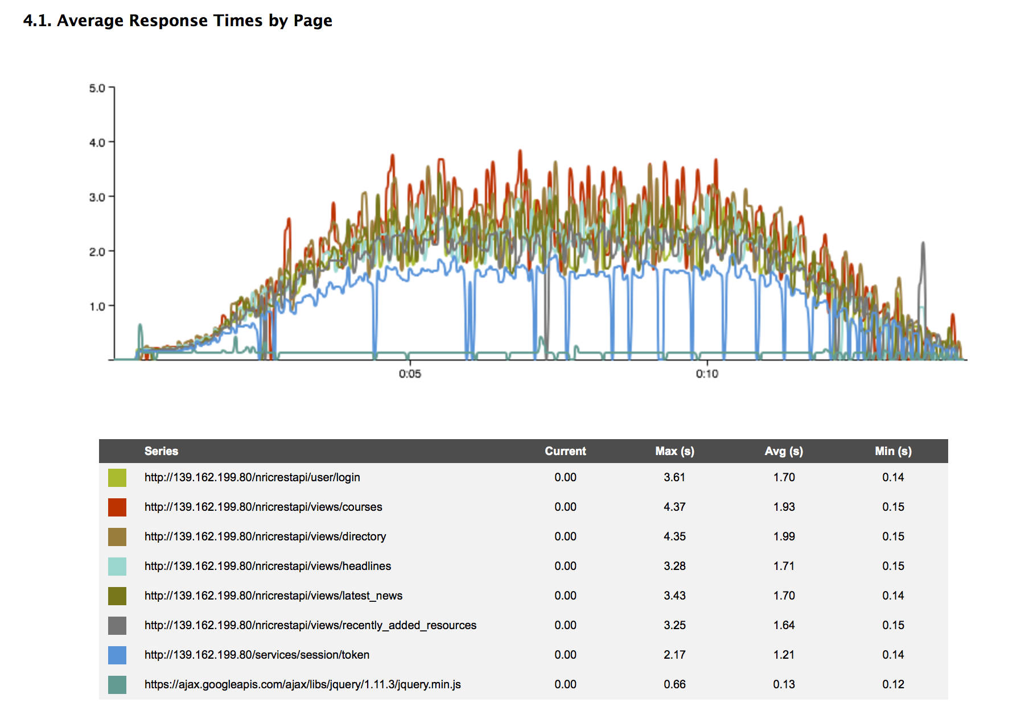
Automated testing
Loadster Stress test

Slide 13
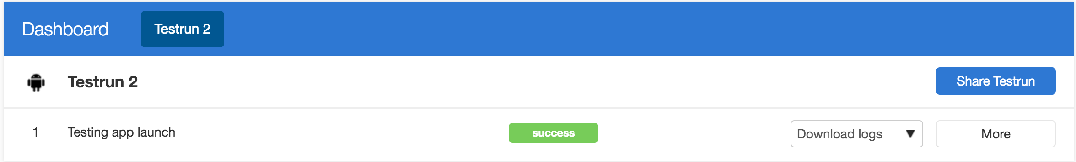
Automated Testing
Testmunk installation and loading test on multiple Android Devices

Slide 14
Successes
App compiles and loads on iOS and Android
User Profiles and Quick Searching work without issues
Responsive for various screen sizes
Uses very little data to fully load the app resources ( approx 200kb — website uses approx 1,5 mb)

Slide 15
Failures
Notification plugin does not load on Android
Some issues with AJAX requests on Phonegap for Android
Users can’t change preferences on main website

Slide 16
Future directions
The system is mostly fit for purpose, although some bugs need to be solved with Phonegap for better app availability
The notifications system can be used as an outbreak alarm
We could integrate WHO, ECDC, HPA resources directly in the app
Get big data (trending articles, most researched areas, etc)

Slide 17
Thank you!

